Slide 1
What categories rented out the most by families?
<visualization>
It is not surprised that families tend to rent more Animation simply it is suitable for almost everyone from toddlers to parents. Even though, the difference between categories is not dramatic big.

Slide 2
How long are family-friendly movies rented out?
<visualization>
It is clearly that the is the length of the rental duration does not depend on whether the movies are family-friendly or not. The length of rental of family-friendly movies are is not different compares to the duration that all movies are rented for.

Slide 3
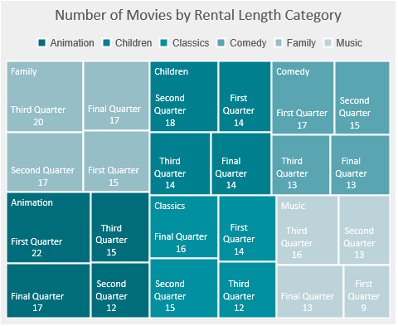
Is there any correlation between movie category and rental duration?
As the chart describes, there is no correlation between movie category and rental duration. For an example, more Animation DVDs are rented out for a short duration while more Classic DVDs are rented out for a long duration.

Slide 4
How are amounts and rental quantities related?
It is common to assume that total revenue should be correlation with number of rentals. However, it does not show that here. Even considering the rental duration, shown in slide 3, it still does not answer the uncorrelation. The answer for this could be the rental rate of some of new and hot family-friendly movies that have been rented out more than usual.

